Slide 1

Phone Class
Attributes and Methods

Slide 2
Purpose
The Phone class’s purpose is to define the different phone options available to the users, and their respective price.
This class is derived from the Device class, which is the Base class for the entire application.

Slide 3
Attribute
Inventory: Phones in stock

Slide 4
Methods
getInventory: Returns inventory variable
setInventory: Assigns the number of phones
displayData: Displays Phone class data

Slide 5
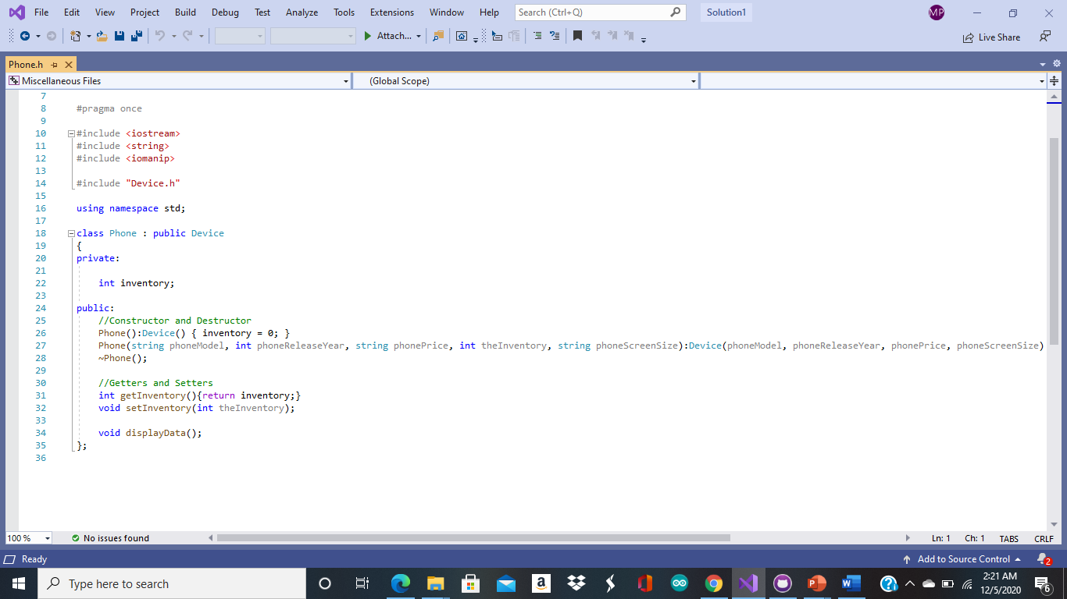
Phone Class Code Screenshot

